Slide 1




Antares Vision Group
DSCSA Portal User Guide

Slide 2


WELCOME TO YOUR PORTAL!
Your DSCSA Portal allows you to track and trace pharmaceutical products in compliance with the Drug Supply Chain Security Act (DSCSA).

Slide 3


Step 1: Account Creation
Provide your supplier with:
GLN for Billing and Ship-to locations
Email to associate with login
Address, City, State, Zip Code

Slide 4

Initial Customer Login
1. Open two emails: one with username, one with temporary password.
2. Navigate to www.rs-dscsa-portal.track-n-trace.net.
3. Log in and change your password.
4. Follow password requirements:
• 1 Uppercase, 1 Lowercase, 1 Number, 1 Special Character.
5. Access ‘DSCSA Compliance Reports’ to view shipments.

Slide 5

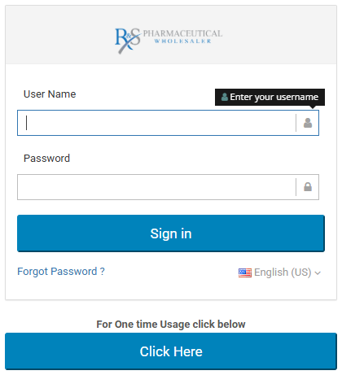

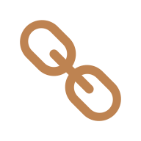
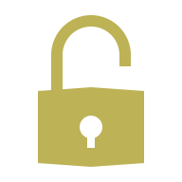

Step 2: Account Activation: Navigate to://https://rs-dscsa-portal.track-n-trace.net/
- Check email for username and temporary password.
- Click the provided link to go to the DSCSA Portal login page.
- Log in with temporary credentials and change your password.
- Sign in again with your new password.

Slide 6
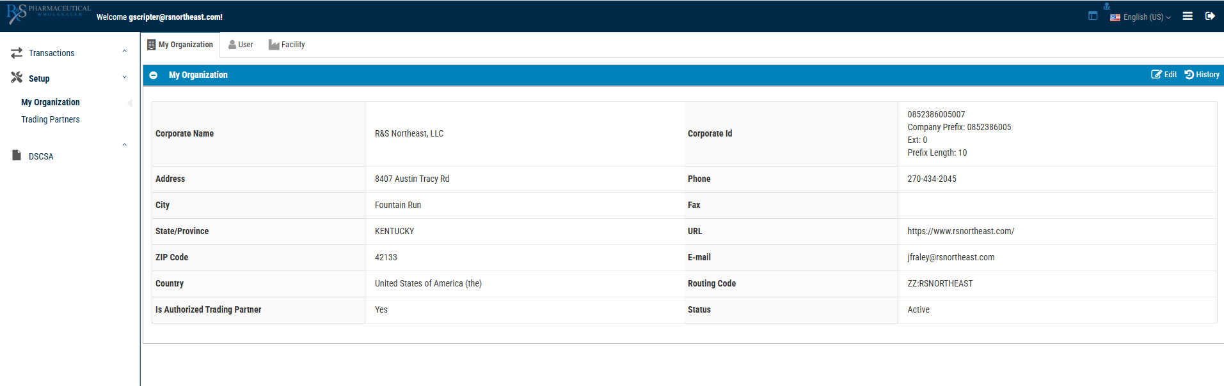
Step 3: Navigating the Portal
- DSCSA > Compliance Reports: View inbound shipments and transaction history.
1
- Setup > My Organization: Review account information.
2
- Refer to ‘Compliance Report Screen’ for detailed navigation steps.

Slide 7
To View your information: Click “Setup” then “My organization”

Slide 8
Navigating the 'DSCSA Compliance Reports' Screen
1. Log in to DSCSA Portal.
1
2. Click 'Search' to open filter options.
2
3. Use filters like Sender, Serial Number, Product Name, Lot ID, or PO#.
3
4. Click 'Document Instance ID' to view shipment details.
4

Slide 9
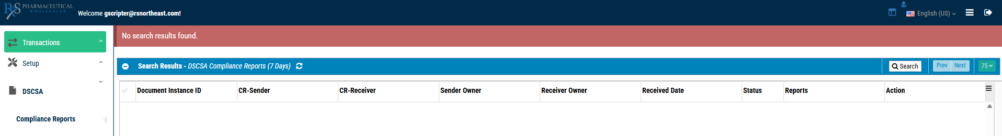
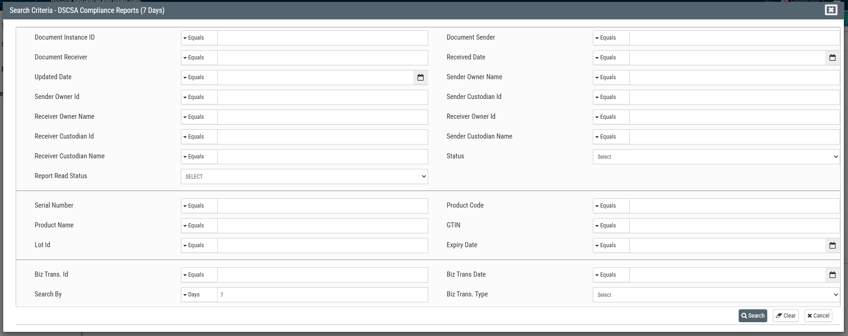
How to Search Compliance Reports with many different query options:

Slide 10
How to Search with PO#
1. In 'Biz Trans ID' field, enter PO#.
2. Select 'Contains' and click 'Search'.
3. Click the result link to view shipment details.
If information needs to be corrected, please contact us at: dscsa@rsnortheast.com

Slide 11
Reset/Forgot Password
1. Click ‘Forgot Password?’ on the login page.
2. Enter your username (email) and click ‘Send’.
3. You’ll receive a temporary password by email.
4. Log in and change your password using the same password rules.

Slide 12



To Log out, click this button at the top right of the screen.
Log Out alert displays, click “Yes”
to fully log out.

Slide 13
Thank You!
Your trust and the continued collaboration as we work together to ensure DSCSA compliance is appreciated.
To update your information:
Contact: sales@rsnortheast.com
DSCSA questions: dscsa@rsnortheast.com

